Slide 1
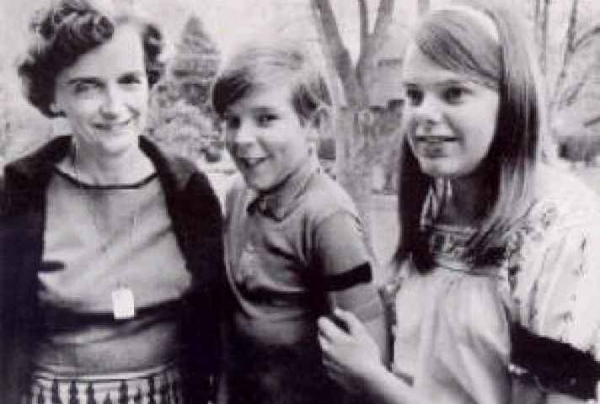
BELL RINGER
Go to Microsoft Forms and answer the review questions about Tinker v. Des Moines.

Slide 2
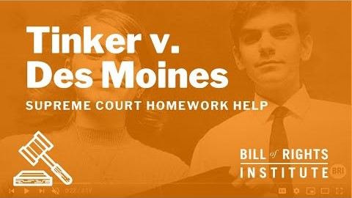
TINKER V. DES MOINES

Slide 3
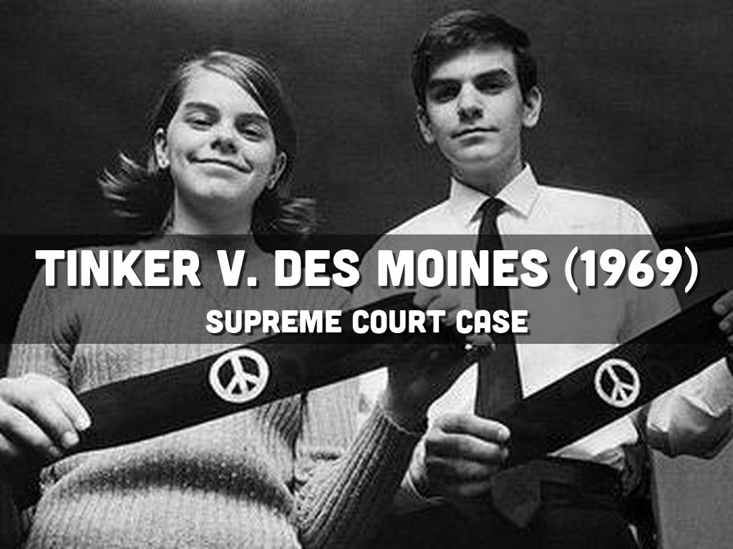
TINKER V. DES MOINES
KEY ISSUES:
Freedom of speech in schools
Symbolic speech
Limits to the 1st Amendment
What is considered “disruptive?”

Slide 4
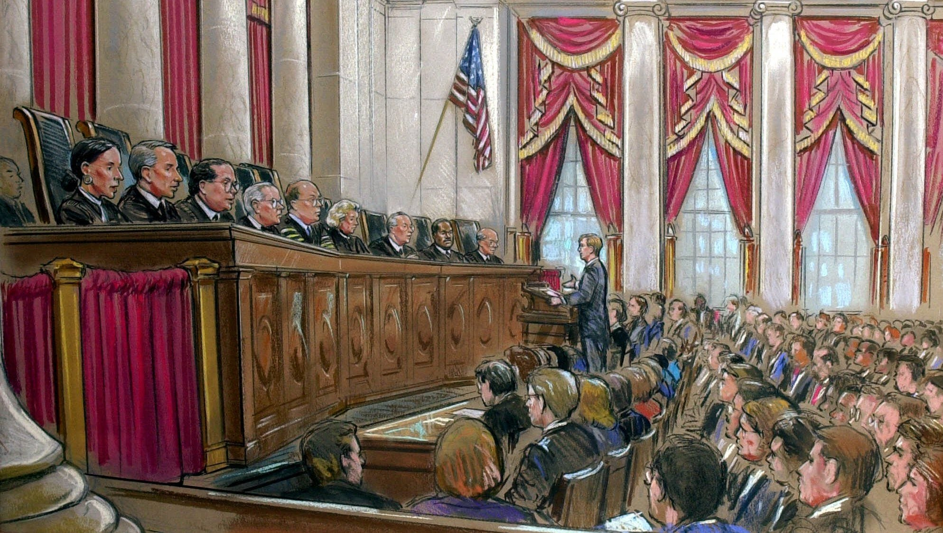
WHAT HAPPENS IN A SUPREME COURT CASE?
The lawyers for both sides make arguments
The justices ask questions
Weeks, even months may pass as the judges research the law and decide how they will vote
The justices vote and write their opinions

Slide 5
RULINGS
MAJORITY OPINION
The decision of more than half of the court and the reasoning behind it.
CONCURRING OPINION
Opinion from a judge who agrees with the outcome of the case but for different reasons than the majority.
DISSENTING OPINION
A legal opinion that thinks the case has been wrongly decided and explains why.

Slide 6
UNDERSTANDING ARGUMENTS AND OPINIONS
In your groups, work together to classify the different arguments made by either side during the case. Determine whether or not the argument would benefit the Tinkers, the school district, both, or neither.

